Slide 1
AIRBNB Case Study
By:
Vijayraj KP
Rudwaan
Sharadhi Kulkarni

Slide 2
Contents
1. Introduction
2. Problem Statement
3. Objectives
4. Key Insights
5. Appendix
About the data
Assumptions

Slide 3
Introduction
Airbnb, Inc. is an American San Francisco-based company operating an online marketplace for short- and long-term homestays and experiences. The company acts as a broker and charges a commission from each booking.
The company is credited with revolutionizing the tourism industry, while also having been the subject of intense criticism by residents of tourism hotspot cities like Barcelona and Venice for enabling an unaffordable increase in home rents, and for a lack of regulation.
New York City is the most diverse and populated city in the United States. The city is made up of 5 burrows: Manhattan, Brooklyn, Queens, the Bronx and Staten Island, all of which were “grouped” together into a single city. It is widely recognized as the global centre for the financial services industry. It’s also the heartbeat of the American media, entertainment (along with California), telecommunications, law and advertising industries.

Slide 4
Problem statement
For the past few months, Airbnb has seen a major decline in revenue. Now that the restrictions have started lifting and people have started to travel more, Airbnb wants to make sure that it is fully prepared for this change.
So, analysis has been done on a dataset consisting of various Airbnb listings in New York.
To prepare for the next best steps that Airbnb needs to take as a business
To Analyse a dataset consisting of various Airbnb listings in New York. Based on this analysis

Slide 5
Objective
The presentation will focus mainly on the following points:
Get a better understanding about Airbnb listings with respect to various parameters
Property demand based on minimum nights offered
Price range preferred by customers
Understanding Price variation w.r.t Room Type & Neighbourhood
Understanding Price variation w.r.t Geography
Top reviewed properties
Availability.

Slide 6
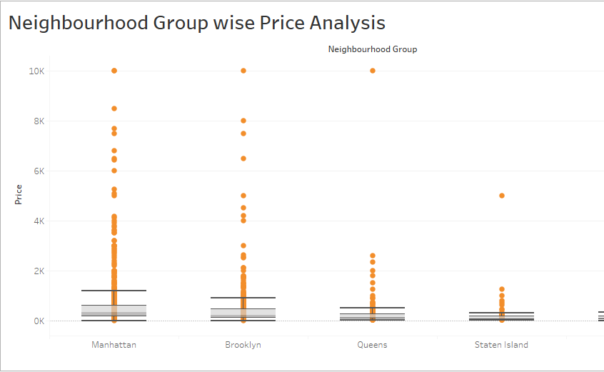
Figure depicts how price range is spread in different cities.
Mangattan ranges from costliest to cheapest hosts.
Brooklyn also sees similar range however there are more gaps in the range.
Bronx sells cheapest accommodation.

Slide 7
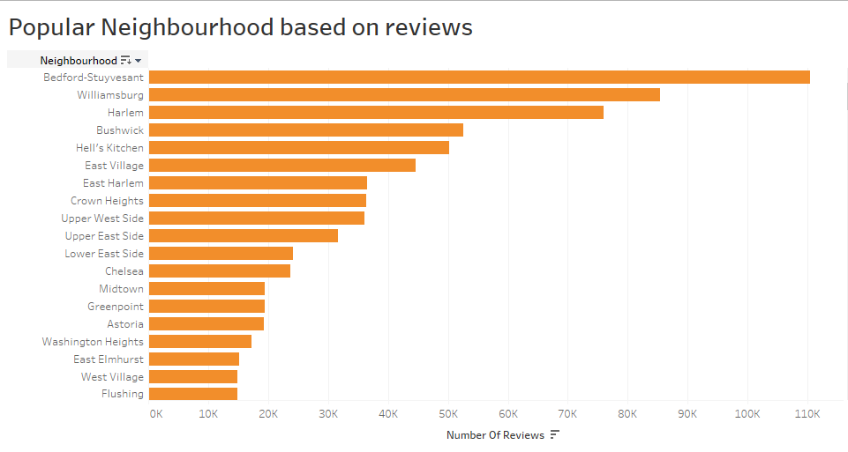
Figure shows which neighborhood got maximum reviews.
Hosts in Bedford-Stuyvesant has got the highest reviews followed by Willianburg. Which means these are most popular neighborhoods.
East Elmhurst, West Village and Flashing are the least reviewed because of their less popularity and accessibility.

Slide 8
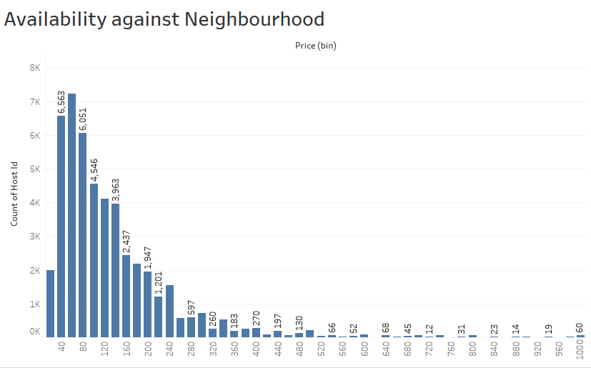
Trent shows most available against Price.
This states that people usually book accommodation based on price.
Maximum people have opted from cheaper to Maiden prices accommodation and also availability is also in the same range.
Accommodation price ranging from 40 to 100 are highest. However accommodation price ranging from 120-240 are also available but less in number.
Accommodation from 250 to 1000 are lease available.

Slide 9
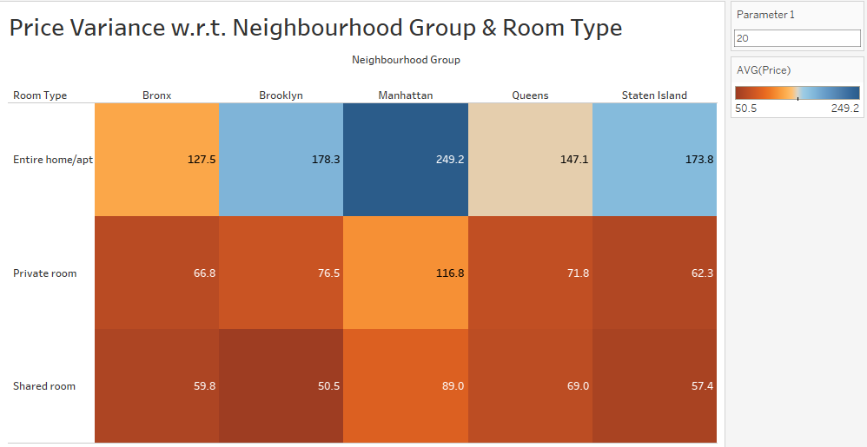
Trent shows average price against Type of room in each city
Average price for different types of room namely Entire Home/Apt, Private room, Shared room is different from city to city.
In previous slide we saw Manhattan having hosts with almost all types of price range. So it has highest average across all types of room. Hot selling one is Entire Home/Apt.
People hardly prefer Shared room in Brooklyn. Although it is the second highest when it comes to price range but lease in Avg Shared room booking.
Statan Island has better average for Entire Home/Apt because of its highest selling room price in that range.

Slide 10
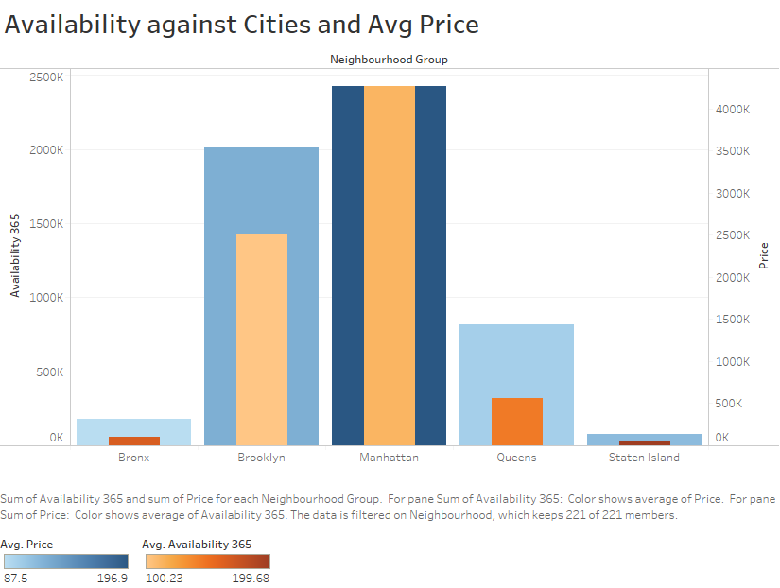
Although Manhattan has highest booking and Price range. Average availability is less in Brooklyn.
Statan Island has the highest availability average.

Slide 11
Recommendations
Marketing should be done for Statan Island and Bronx as it has less bookings. Also more properties should be acquired or tagged with the company in these areas.
Shared Accommodation should be concentrated more as it has lease bookings.
More properties can be considered in Brooklyn so work on average availability. It has the less average availability compared to other areas.
Special offers can be given in Statan Island and Bronx to increase booking in those areas.
Since Entire home/Apt is booked most in Mangattan and Brooklyn, Hosts in Queens can be given offers on this type of property to increase booking.

Slide 12
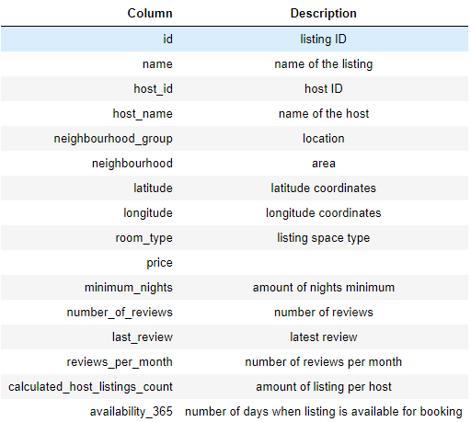
Appendix
About the data
Provided with Airbnb New York City Listings Dataset till 2019 (48895 Rows * 16 Columns)

Slide 13
Assumptions
As we are not aware about the nature of reviews, we have assumed that the properties which received higher number of reviews have a better customer liking.

Slide 14
Thank you

